Slide 1
IPL Match Winner Prediction Using Machine Learning
Presented by
Harish P

Slide 2
INTRODUCTION
Overview of the Problem:
The project focuses on predicting the winner of IPL cricket matches using machine learning techniques.
The aim is to use historical match data to create a reliable prediction system that identifies the probable winner of a match.
Brief Explanation Of The Dataset:
Dataset includes key features such as season, teams, toss details, match result, and venue.
Data is processed and analyzed using Python libraries like Pandas, NumPy, Matplotlib, and Seaborn.
The dataset provides both numerical and categorical features, suitable for supervised learning.
Objective of the Project:
To preprocess and analyze the IPL dataset.
To build predictive models using algorithms like Logistic Regression, SVM, KNN, Decision Tree, Random Forest, and Gradient Boost.
To evaluate performance using metrics such as accuracy, precision, recall, and F1-score.
To tune hyperparameters and select the best-performing model for prediction.

Slide 3
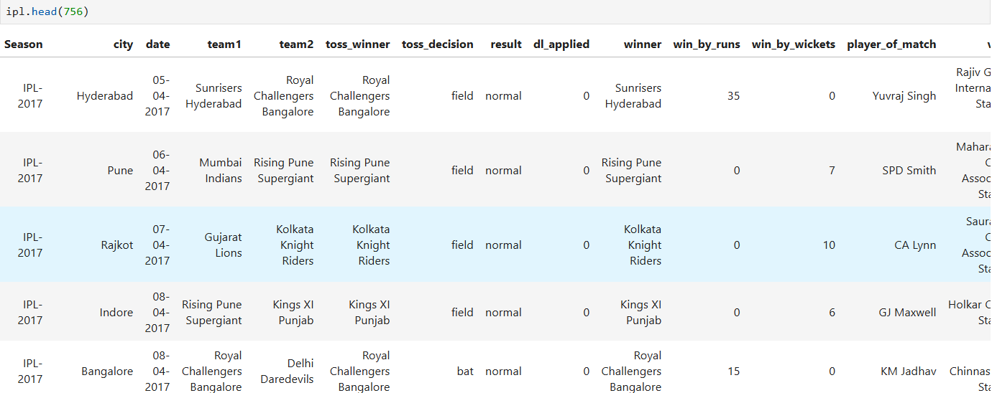
DATA UNDERSTANDING
The dataset contains historical IPL match details.
Key columns include:
Season – The year of the IPL season.
Team1 & Team2 – Competing teams.
Toss Winner – The Team winning the toss.
Toss Decision – Whether the toss winner chose to bat or field.
Venue – Stadium where the match was played.
Winner – Team that won the match.
Player of the Match – Best-performing player.
Win By Runs / Wickets – Margin of victory.
Date – Date when the match took place.

Slide 4
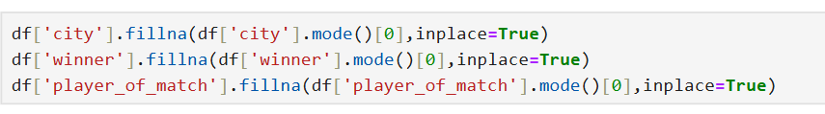
Data Cleaning
Removed duplicate rows to avoid repeated match records.
Checked for missing values and handled them properly.
Standardized column names for easy reading and analysis.
Cleaned extra spaces & special characters in text columns.
Converted date and numeric columns into correct data types.
Replaced or removed invalid or inconsistent entries.
Ensured all team names and player names follow a consistent format.
Verified cleaned data to make sure it is ready for analysis.
Checked for missing values in important columns.
Replaced missing values in ‘city’ column using the mode (most common value).
Filled missing values in ‘winner’ column with the mode to avoid losing records.
Replaced missing values in ‘player_of_match’ column with the most frequent value.
Used fillna() with inplace=True to update the DataFrame directly.
Ensured no empty cells remain in these key columns after cleaning.

Slide 5
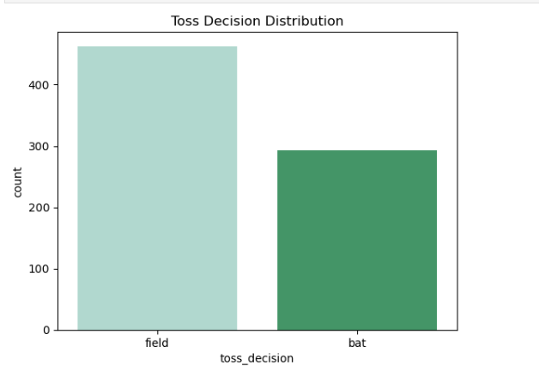
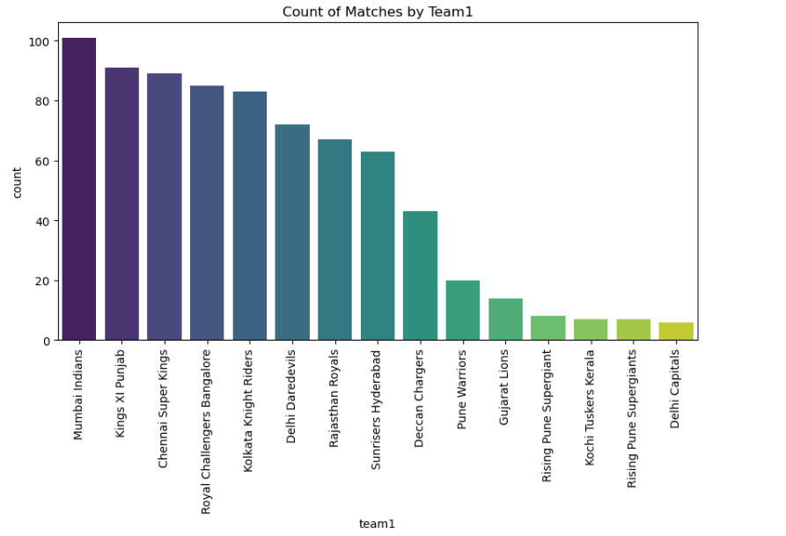
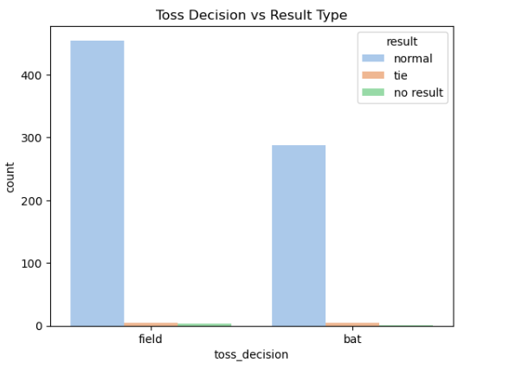
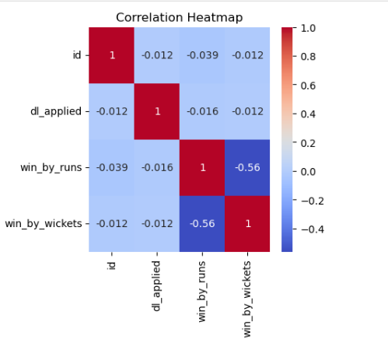
Exploratory Data Analysis (EDA)
📊 Key Insights from EDA
Toss Decision Distribution
Most teams prefer to field first after winning the toss.
“Field” decisions are significantly higher than “Bat”.
Matches by Team
Teams like Mumbai Indians and Kolkata Knight Riders have played the most matches.
Newer or less successful teams appear less frequently.
Toss Decision vs Result Type
Almost all matches end with a “normal” result, regardless of toss decision.
Very few matches end in “tie” or “no result” situations.
Correlation Heatmap
win_by_runs and win_by_wickets show a negative correlation, meaning teams usually win either by runs or by wickets, not both.
Other numeric columns (id, dl_applied) show weak or no correlation with the result columns.

Slide 6
MODEL PROCESS
Input Data
Models
Hyperparameter tuning
Evaluation metrics
Logistic regression
SVM
KNN
Decision trees
Random forest
Xgboost
Grid Search
Random Search
Accuracy
Confusion Matrix
Precision
Recall
F1 Score.

Slide 7
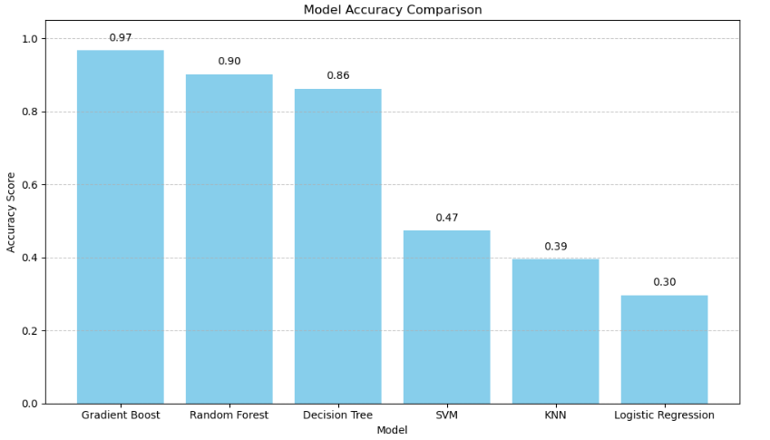

MODEL COMPARISON
Top Takeaways
🥇 Gradient Boost dominates with an accuracy of 0.97, making it the most reliable model for your dataset.
🌲 Random Forest is a strong second at 0.90, offering good performance with ensemble stability.
🌳 Decision Tree scores 0.86, decent but less robust than its ensemble cousins.
📉 Poor performers:
SVM: 0.47
KNN: 0.39
Logistic Regression: 0.30 These models may be underfitting or not well-suited to the data's structure.
Gradient Boost

Slide 8
CONCLUSION
Model Improvement
Apply feature engineering (e.g., combining date & time into peak/off-peak features).
Use scaling & normalization for better model performance.
Test multiple algorithms (Logistic Regression, Decision Trees, Random Forest, GradientBoost).
Apply cross-validation to avoid overfitting and improve generalization.
Fine-tune hyperparameters using GridSearch/RandomSearch.
Incorporate regularization (L1/L2) to handle noise and multicollinearity.
Evaluate models with diverse metrics (MAE, RMSE, R², Accuracy).
Future Feature Steps
Add seasonality features (day, month, holidays, weather impact on sales).
Perform customer segmentation for targeted analysis (loyal vs. occasional buyers).
Introduce product categorization (beverages vs. snacks vs. combos).
Create time-based features (hour of day, weekday vs. weekend trends).
Track discounts & promotions impact on sales.
Integrate external datasets (events, local traffic, weather data).
Build predictive dashboards for real-time sales monitoring.

Slide 9
THANK YOU

